Slide 1

Note: The data and information in this document is reflective of a hypothetical situation and client. This document is to be used for KPMG Virtual Internship purposes only.
Sprocket Central Pty Ltd
Data analytics approach
[Division Name] - [Engagement Manager], [Senior Consultant], [Junior Consultant]

Slide 2
Note: The data and information in this document is reflective of a hypothetical situation and client. This document is to be used for KPMG Virtual Internship purposes only.
Agenda
Introduction
Data Exploration
Model Development
Interpretation

Slide 3
Note: The data and information in this document is reflective of a hypothetical situation and client. This document is to be used for KPMG Virtual Internship purposes only.
Introduction
Bike sales for new customers are most affected by these factors
Gender Differences
Age Differences
Occupation of Customer

Slide 4
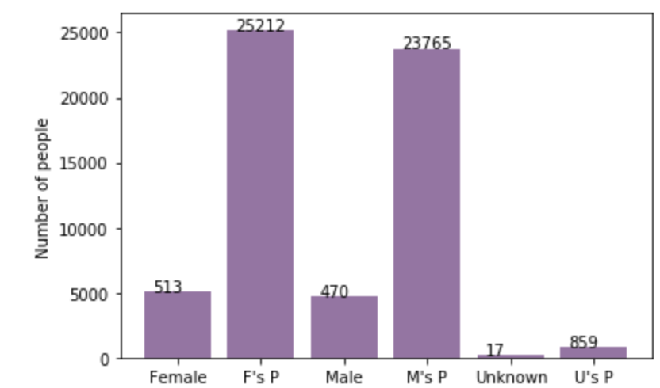
Note: The data and information in this document is reflective of a hypothetical situation and client. This document is to be used for KPMG Virtual Internship purposes only.
Bike sales vs Customer Gender Analysis
There are 4.7% more female customers (51.7%) than male customers (47%)
Females account for 50.58% of total bikes sold while Males account for 47.68%

Slide 5
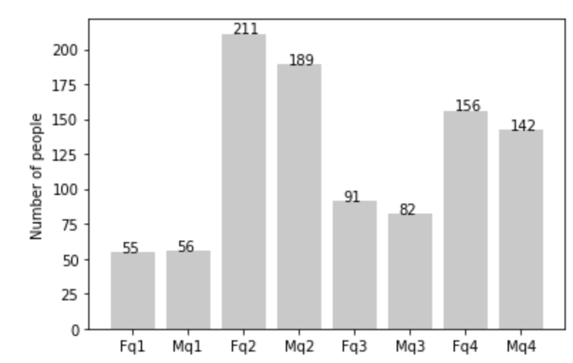
Note: The data and information in this document is reflective of a hypothetical situation and client. This document is to be used for KPMG Virtual Internship purposes only.
Bike sales vs Age of Customers
Age (Mean) : 49.0 Age (Standard Deviation) : 17.0
F: Female M: Male
q1: age <= mean – sd/2 (age <= 40.5)
q2: mean – sd/2 < age <= mean (age = [40.5,49])
q3: mean < age <= mean + sd/2 (age = [49,57.5])
q4 : mean + sd/2 < age (age > 57.5)
Most of the customers are in the age groups:
40.5 < ages <= 49 accounting for 40.7%
Ages > 57 accounting for 30.3%

Slide 6
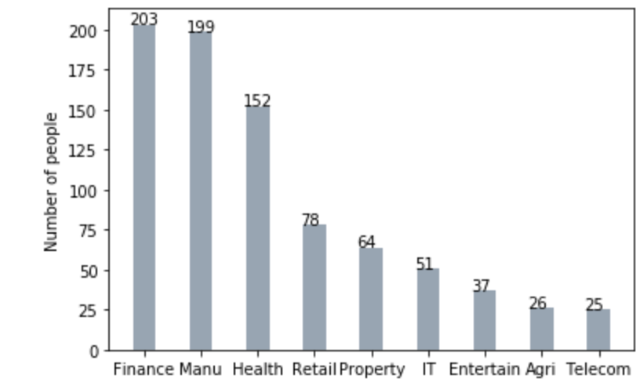
Note: The data and information in this document is reflective of a hypothetical situation and client. This document is to be used for KPMG Virtual Internship purposes only.
Bike Sales vs Occupation of Customer
The top 3 occupations of new Customers are:
Finance
Manufacturing
Health

Slide 7
Note: The data and information in this document is reflective of a hypothetical situation and client. This document is to be used for KPMG Virtual Internship purposes only.
Appendix

